Slide 1
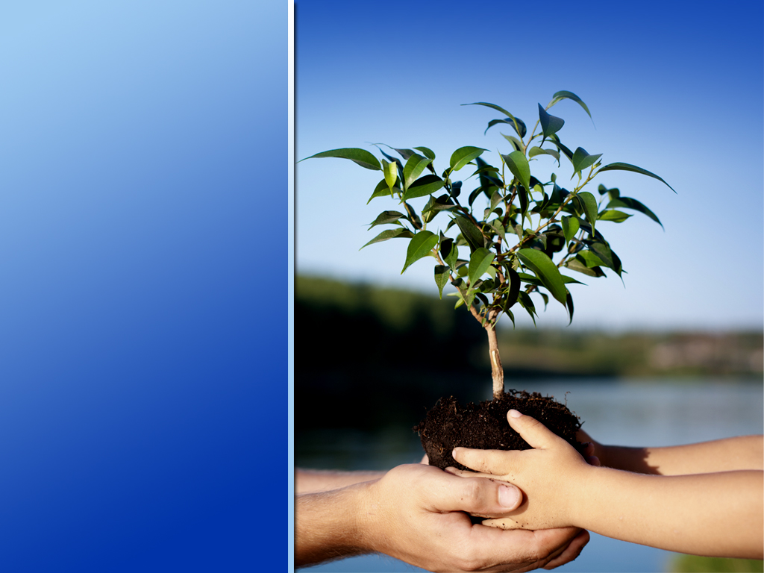

Soil and Water Conservation Merit Badge
Troop 344 and 9344
Pemberville, OH

Slide 2
Soil and Water Conservation Merit Badge Requirements
Do the following:
  Tell what soil is. Tell how it is formed.
  Describe three kinds of soil. Tell how they are different.
  Name the three main plant nutrients in fertile soil. Tell how they can be put back when used up.
Do the following:
  Define soil erosion.
  Tell why soil conservation is important. Tell how it affects you.
  Name three kinds of soil erosion. Describe each.
  Take pictures of or draw two kinds of soil erosion.
Do the following:
  Tell what is meant by "conservation practices".
  Describe the effect of three kinds of erosion-control practices.
  Take pictures of or draw three kinds of erosion-control practices.

Slide 3
Soil and Water Conservation Merit Badge Requirements
Do the following:
  Explain what a watershed is.
  Outline the smallest watershed that you can find on a contour map.
  Outline, as far as the map will allow, the next larger watershed which also has the smaller one in it.
  Explain what a river basin is. Tell why all people living in a river basin should be concerned about land and water use in the basin.
  Explain what an aquifer is and why it can be important to communities.
Do the following:
  Make a drawing to show the hydrologic cycle.
  Demonstrate at least two of the following actions of water in relation to the soil: percolation, capillary action, precipitation, evaporation, transpiration.
  Explain how removal of vegetation will affect the way water runs off a watershed.
  Tell how uses of forest, range, and farmland affect usable water supply.
  Explain how industrial use affects water supply.

Slide 4
Soil and Water Conservation Merit Badge Requirements
Do the following:
  Tell what is meant by "water pollution".
  Describe common sources of water pollution and explain the effects of each.
  Tell what is meant by "primary water treatment," "secondary waste treatment," and "biochemical oxygen demand."
  Make a drawing showing the principles of complete waste treatment.

Slide 5
Soil and Water Conservation Merit Badge Requirements
Do TWO of the following:
  Make a trip to two of the following places. Write a report of more than 500 words about the soil and water and energy conservation practices you saw.
    An agricultural experiment.
    A managed forest or a woodlot, range, or pasture.
    A wildlife refuge or a fish or game management area.
    A conservation-managed farm or ranch.
    A managed watershed.
    A waste-treatment plant.
    A public drinking water treatment plant.
    An industry water-use installation.
    A desalinization plant.
  Plant 100 trees, bushes and/or vines for a good purpose.
  Seed an area of at least one-fifth acre for some worthwhile conservation purposes, using suitable grasses or legumes alone or in a mixture.
  Study a soil survey report. Describe the things in it. Using tracing paper and pen, trace over any of the soil maps, and outline an area with three or more different kinds of soil. List each kind of soil by full name and map symbol.
  Make a list of places in your neighborhood, camps, school ground, or park having erosion, sedimentation, or pollution problems. Describe how these could be corrected through individual or group action.
  Carry out any other soil and water conservation project approved by your merit badge counselor.

Slide 6

Requirement 1
Do the following:
  Tell what soil is. Tell how it is formed.
  Describe three kinds of soil. Tell how they are different.
  Name the three main plant nutrients in fertile soil. Tell how they can be put back when used up.

Slide 7
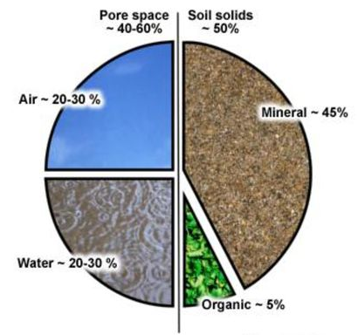
Soil
Soil is a self-renewing compound of rock and mineral particles, organic material, living organisms, air, and moisture.

Slide 8
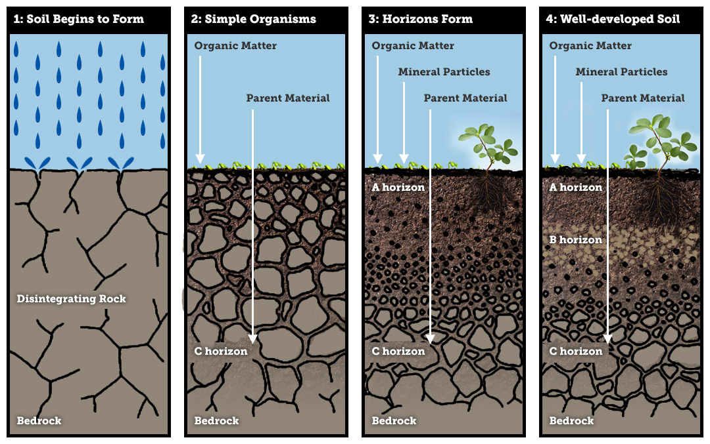
Formation of Soil
The formation of soil begins with the weathering of bare rock and sediment surfaces that disintegrate under the influence of climate.
Freezing and thawing, wind, water and gravity break soil parent material into smaller units or cause solid rock to crack.

Slide 9
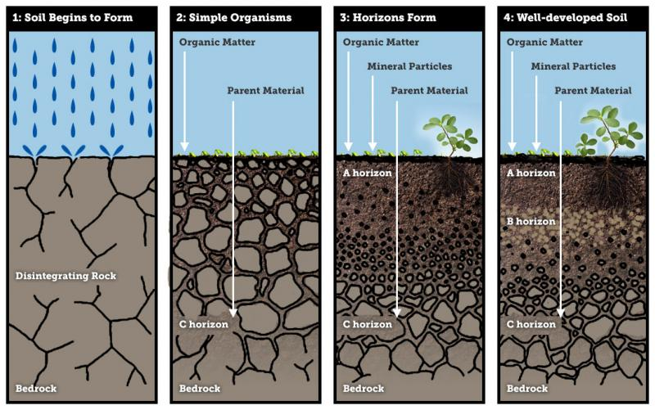
Formation of Soil
Pioneering vegetation ­– lichens at first – begins to settle and put out roots to nestle in loose fragments of rock, cracks or sediment.
Once a thin blanket of vegetation has established and organic matter starts to decompose, organic acids promote further disintegration of the initial rock or sediment material.
With time, life infuses through the soil body and blossoms on its surface while biological, chemical and physical weathering continues.
A new soil environment has formed.

Slide 10

Requirement 1
Do the following:
  Tell what soil is. Tell how it is formed.
  Describe three kinds of soil. Tell how they are different.
  Name the three main plant nutrients in fertile soil. Tell how they can be put back when used up.

Slide 11
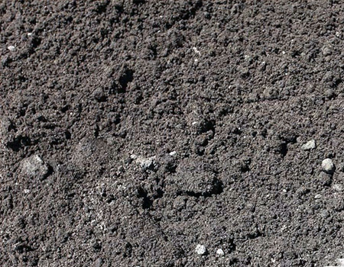
Types of Soil: Sandy
Sandy Soil is light, warm, dry and tend to be acidic and low in nutrients.
Sandy soils are often known as light soils due to their high proportion of sand and little clay (clay weighs more than sand).
These soils have quick water drainage and are easy to work with.
They are quicker to warm up in spring than clay soils but tend to dry out in summer and suffer from low nutrients that are washed away by rain.

Slide 12
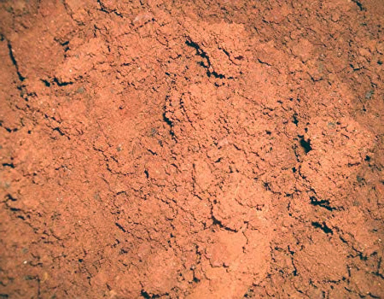
Types of Soil: Clay
Clay Soil is a heavy soil type that remains wet and cold in winter and dries out and cracks in the summer.
These soils are made of over 25 percent clay, and because of the spaces found between clay particles, clay soils hold a high amount of water.
These soils drain slowly and take longer to warm up in summer.

Slide 13
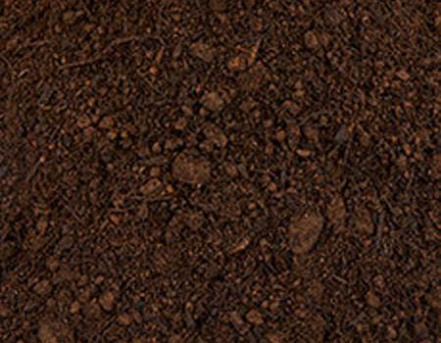
Types of Soil: Loam
Loam Soil is a mixture of sand, silt and clay that are combined to avoid the negative effects of each type.
These soils are fertile, easy to work with and provide good drainage.
Depending on their predominant composition they can be either sandy or clay loam.

Slide 14
Requirement 1
Do the following:
  Tell what soil is. Tell how it is formed.
  Describe three kinds of soil. Tell how they are different.
  Name the three main plant nutrients in fertile soil. Tell how they can be put back when used up.

Slide 15
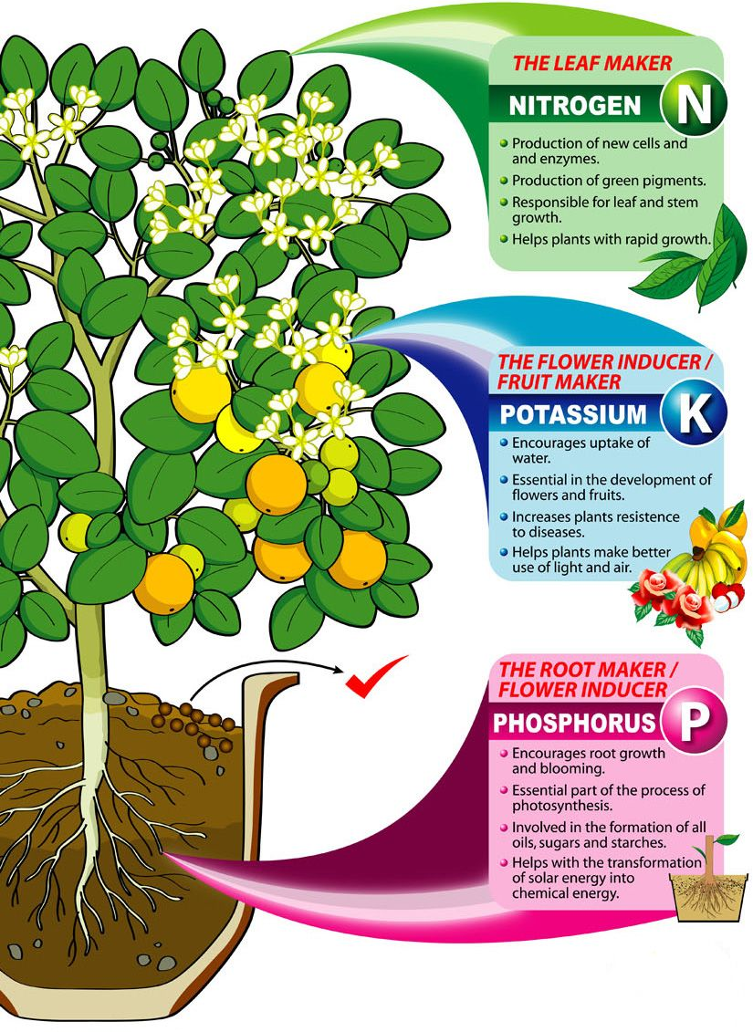
Plant Nutrients in the Soil
The three main nutrients are nitrogen (N), phosphorus (P) and potassium (K).
Together they make up the trio known as NPK.
Other important nutrients are calcium, magnesium and sulfur.
Plants also need small quantities of iron, manganese, zinc, copper, boron and molybdenum, known as trace elements because only traces are needed by the plant.

Slide 16
Replacing Nutrients
Nitrogen (N)
  Fertilizer factories use nitrogen from the air to make ammonium sulfate, ammonium nitrate and urea. When applied to soil, nitrogen is converted to mineral form, nitrate, so that plants can take it up. Soils high in organic matter or from application of composted manure are generally higher in nitrogen.
Phosphorus (P)
  A major source of phosphorus is bone meal. Pulverized rock phosphate is a phosphorus-rich rock that is ground into fine particles that release their phosphorus slowly and over the course of many years. All manures contain phosphorus, but manure from grain-fed animals is a particularly rich source.
Potassium (K)
  Potash, mined rock powders and wood ash, is the most common source of potassium applied by farmers.

Slide 17
Requirement 2
Do the following:
  Define soil erosion.
  Tell why soil conservation is important. Tell how it affects you.
  Name three kinds of soil erosion. Describe each.
  Take pictures of or draw two kinds of soil erosion.

Slide 18
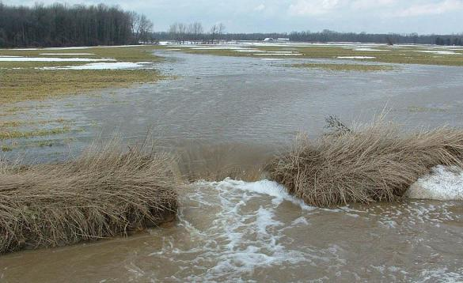
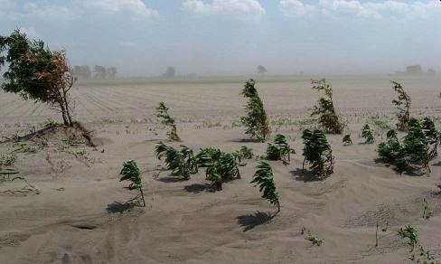
Soil Erosion
In agriculture, Soil Erosion refers to the wearing away of a field's topsoil by the natural physical forces of water and wind or through forces associated with farming activities such as tillage.

Slide 19
Requirement 2
Do the following:
  Define soil erosion.
  Tell why soil conservation is important. Tell how it affects you.
  Name three kinds of soil erosion. Describe each.
  Take pictures of or draw two kinds of soil erosion.

Slide 20

Importance of Soil Conservation
The soil is the foundation of plant life. A tree will not be a tree without soil. While there are some plants that can live in water or air, most plants need to be rooted to the ground.
The soil provides nutrition to plant life that nourishes humankind and the animal kingdom.
The soil is necessary for water supply and the land ensures the quality of water we derive from our earth.

Slide 21
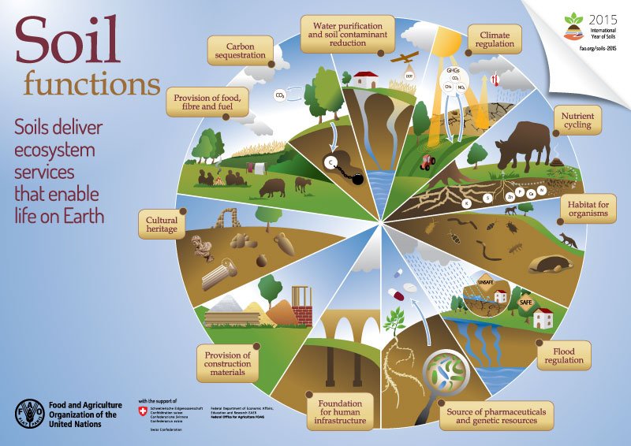

Slide 22
Requirement 2
Do the following:
  Define soil erosion.
  Tell why soil conservation is important. Tell how it affects you.
  Name three kinds of soil erosion. Describe each.
  Take pictures of or draw two kinds of soil erosion.

Slide 23
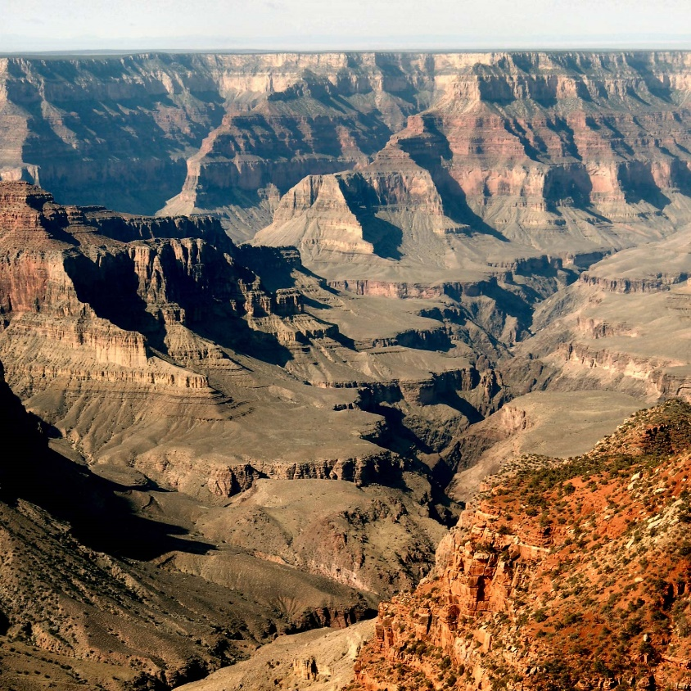
Geologic Soil Erosion
Geologic Erosion is a normal or natural erosion caused by geologic processes acting over long geologic periods and resulting in the wearing away of mountains, the building up of flood plains etc.
Geologic erosion usually moves so slowly that, when there is much native plant cover, soil is built up and seldom destroyed, and in a lifetime one could scarcely see the change it brings.

Slide 24
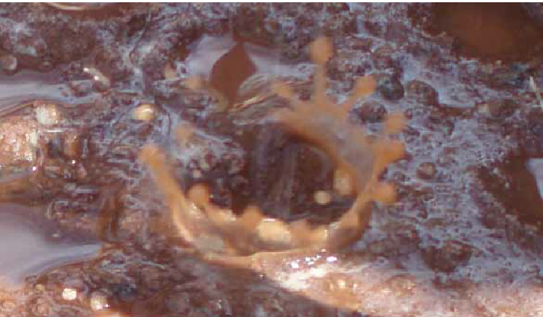
Soil Erosion by Water
Splash Erosion
The force of a single raindrop won’t move much soil, but when billions of raindrops together hammer against bare ground, they tear clumps of soil apart and separate the tiny particles from each other.
As they bounce into the air after striking the ground, the raindrops carry some soil particles with them; these bits of soil gradually move downhill.

Slide 25
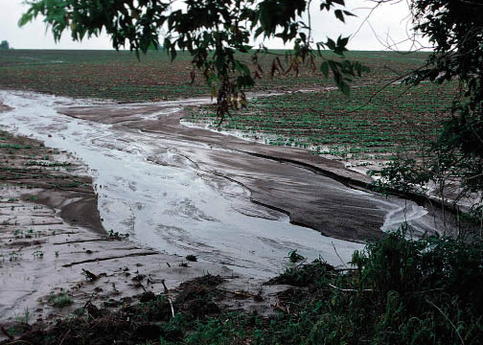
Soil Erosion by Water
Sheet Erosion
Whenever rain falls or snow melts so fast that the water cannot soak into the soil, a sheet of water collects on the surface and moves downhill.
On sloping land with little vegetation, such as a new building site, an overgrazed pasture, or a newly plowed field, the combined action of beating raindrops and flowing water continuously washes away thin layers of surface soil.

Slide 26
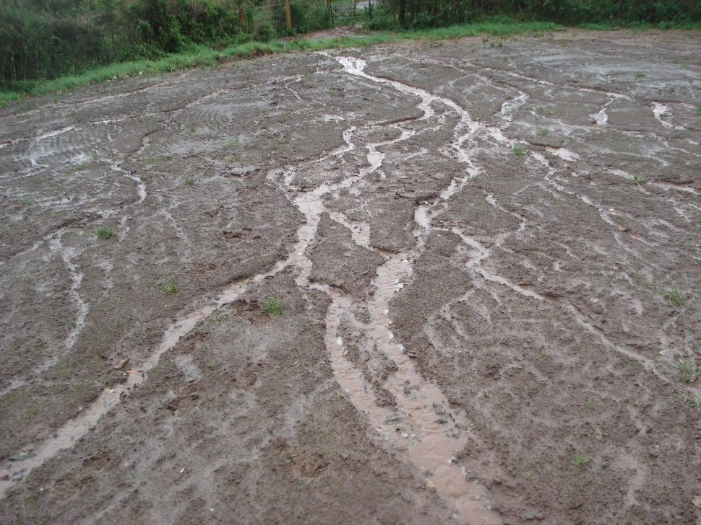
Soil Erosion by Water
Rill Erosion
As water moves over the land surface, collects in little streams, and continues to run down a slope, it tears away more soil particles until it carves small, irregular channels called rills.
On much sloping land, the small rills join somewhere on the slope to make larger channels.

Slide 27
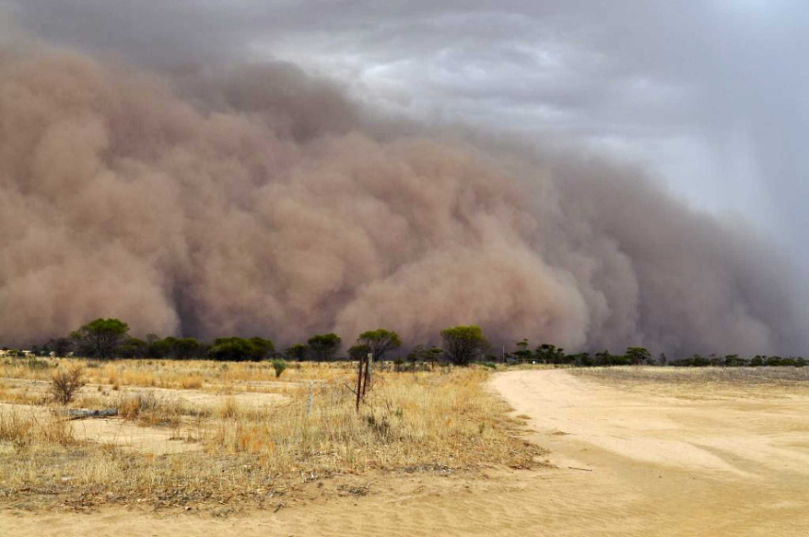
Soil Erosion by Wind
Wind Erosion usually starts on land that has few plants and sandy soils.
The wind picks up a few loose soil particles, and when these strike bare ground, they blast loose other particles that in turn are bounced and swept along the ground surface, causing further erosion.
The blowing soil particles can cut off tender, growing plants at the ground surface or they can cover both growing and dead vegetation with drifts and mounds of dust or sand.
When the growing plants are cut off, the soil they protected from the wind will erode.

Slide 28
Requirement 2
Do the following:
  Define soil erosion.
  Tell why soil conservation is important. Tell how it affects you.
  Name three kinds of soil erosion. Describe each.
  Take pictures of or draw two kinds of soil erosion.

Slide 29
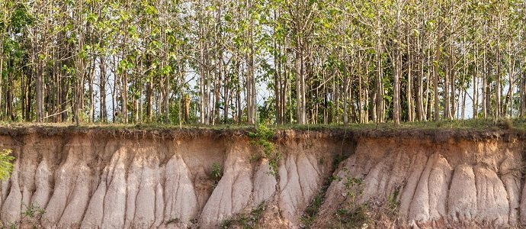
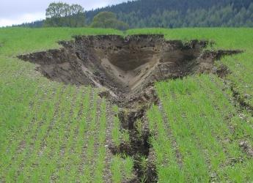
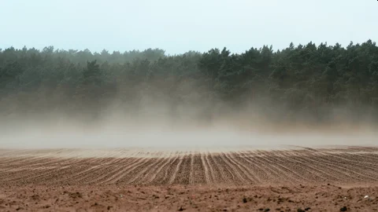
Soil Erosion

Slide 30
Requirement 3
Do the following:
  Tell what is meant by "conservation practices".
  Describe the effect of three kinds of erosion-control practices.
  Take pictures of or draw three kinds of erosion-control practices.

Slide 31
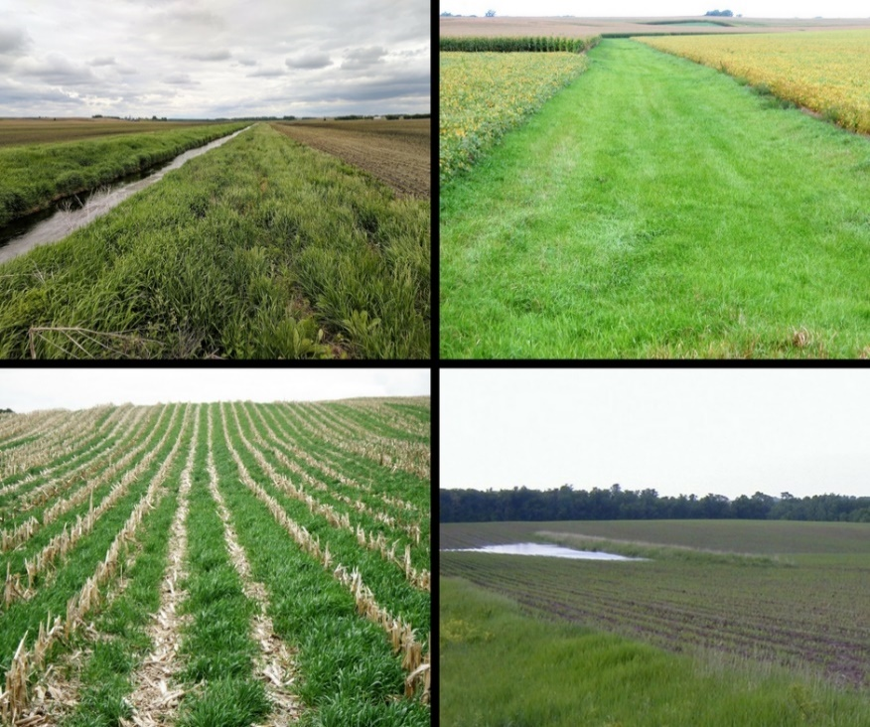
Conservation Practices
With the help of the local Soil and Water Conservation District, Natural Resource Conservation Service, Farm Service Agency, and Cooperative Extension, farmers are employing a variety of conservation practices on their farms.
The purpose of these practices is to slow or control water runoff, and to trap sediment and nutrients.

Slide 32
Requirement 3
Do the following:
  Tell what is meant by "conservation practices".
  Describe the effect of three kinds of erosion-control practices.
  Take pictures of or draw three kinds of erosion-control practices.

Slide 33
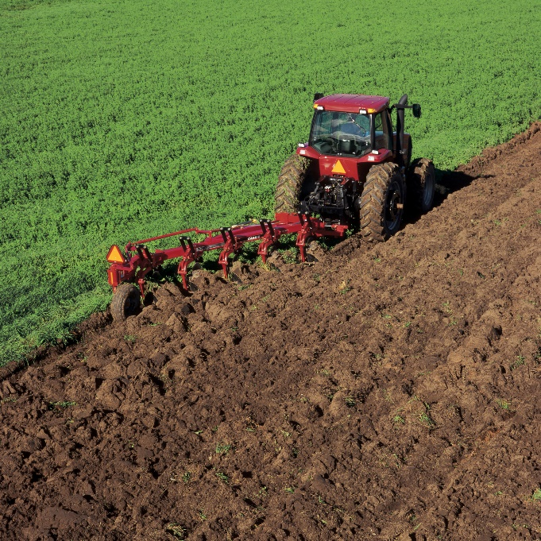
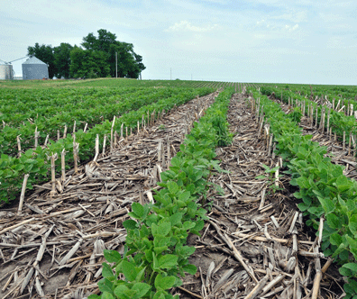
Conservation Tillage
Conventional tillage, such as moldboard plowing, leaves the soil surface bare and loosens soil particles, making them susceptible to the erosive forces of wind and water.
Conservation Tillage is any tillage and planting system that leaves at least 30 percent of the soil surface covered by residue after planting.
  i.e. No-till leaves the soil undisturbed from harvest to planting.
Conservation tillage practices reduce erosion by protecting the soil surface and allowing water to infiltrate instead of running off.

Slide 34
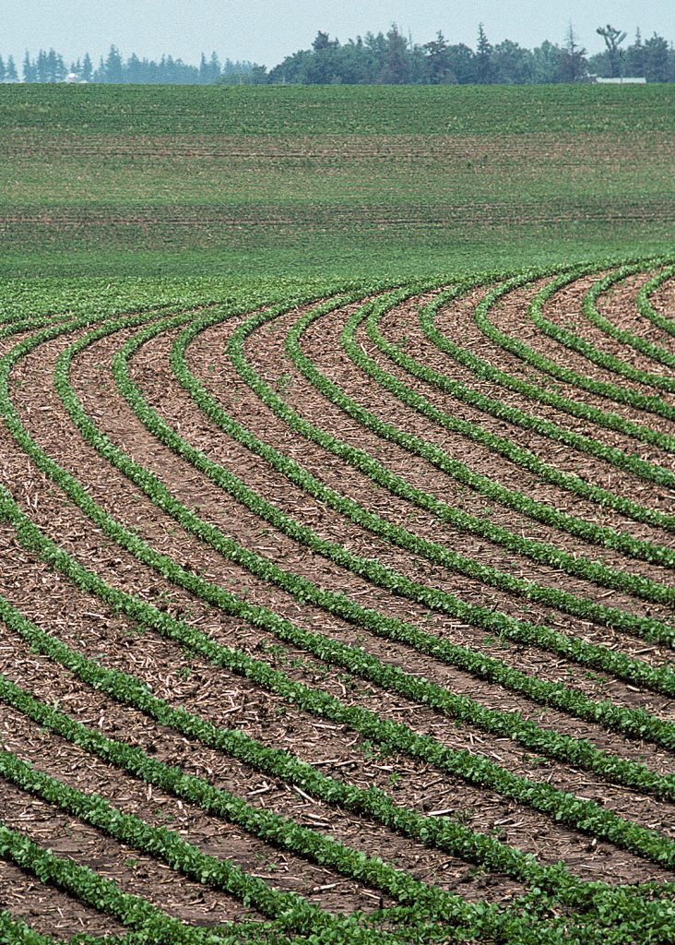
Contour Ridge Tillage
In Contour Ridge Tillage a ditch or ridge along sloping land contour is constructed to shorten the slope length and change the direction of runoff flow for the purpose of storing water, preventing scouring and combating drought and soil erosion.

Slide 35
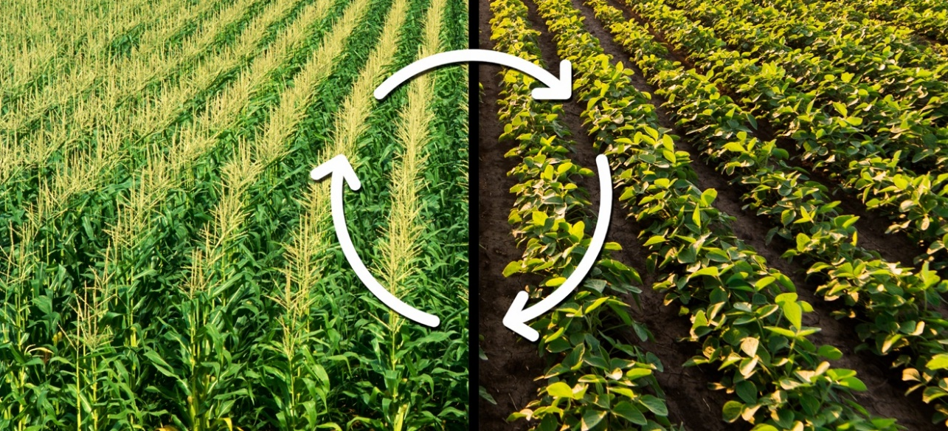
Crop Rotation
Crop Rotation is the practice of growing a series of different types of crops in the same area across a sequence of growing seasons.
It reduces reliance on one set of nutrients, pest and weed pressure, and the probability of developing resistant pests and weeds.

Slide 36
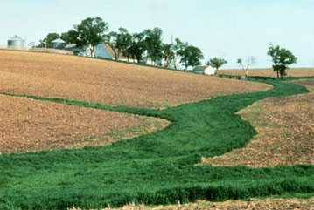
Grassed Waterways
Grassed Waterways are broad, shallow, shaped channels designed to carry surface water across farmland without causing soil erosion.
The vegetative cover and root system in the waterway slows the runoff water flow and protects the channel from erosion.

Slide 37
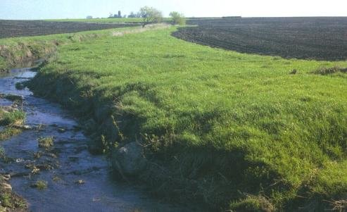
Filter Strips
A Filter Strip is an area of grass or other permanent vegetation beside a stream or ditch and is used to reduce or intercept sediment, organics, nutrients, pesticides, and other contaminants from runoff and to maintain or improve water quality.

Slide 38
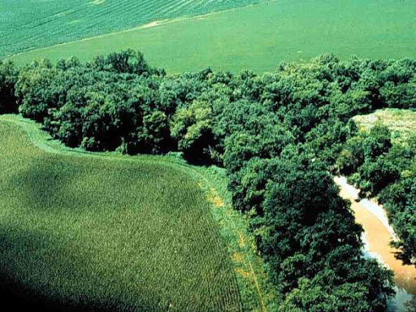
Riparian Buffers
A Riparian Buffer or stream buffer is a vegetated area near a stream, usually forested, which helps shade and partially protect the stream from the impact of adjacent land uses.
It plays a key role in increasing water quality in associated streams, rivers, and lakes, thus providing environmental benefits.

Slide 39
Requirement 3
Do the following:
  Tell what is meant by "conservation practices".
  Describe the effect of three kinds of erosion-control practices.
  Take pictures of or draw three kinds of erosion-control practices.

Slide 40
Requirement 4
Do the following:
  Explain what a watershed is.
  Outline the smallest watershed that you can find on a contour map.
  Outline, as far as the map will allow, the next larger watershed which also has the smaller one in it.
  Explain what a river basin is. Tell why all people living in a river basin should be concerned about land and water use in the basin.
  Explain what an aquifer is and why it can be important to communities.

Slide 41
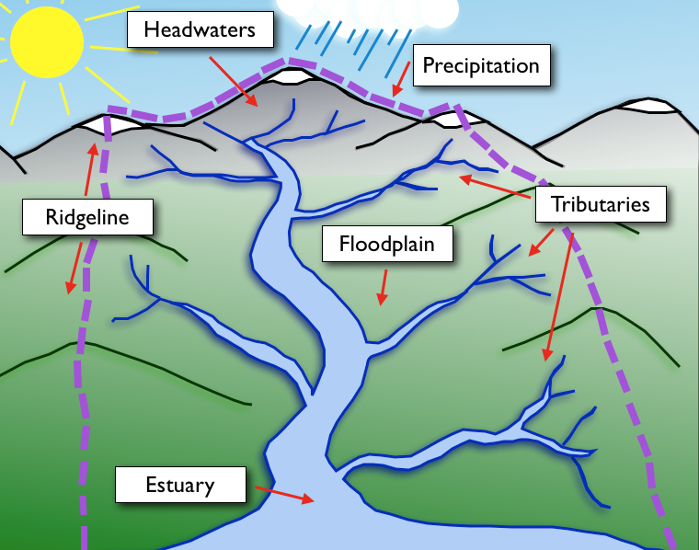
Watershed
A Watershed is any area of land where precipitation collects and drains off into a common outlet, such as into a river, bay, or other body of water.

Slide 42
Requirement 4
Do the following:
  Explain what a watershed is.
  Outline the smallest watershed that you can find on a contour map.
  Outline, as far as the map will allow, the next larger watershed which also has the smaller one in it.
  Explain what a river basin is. Tell why all people living in a river basin should be concerned about land and water use in the basin.
  Explain what an aquifer is and why it can be important to communities.

Slide 43
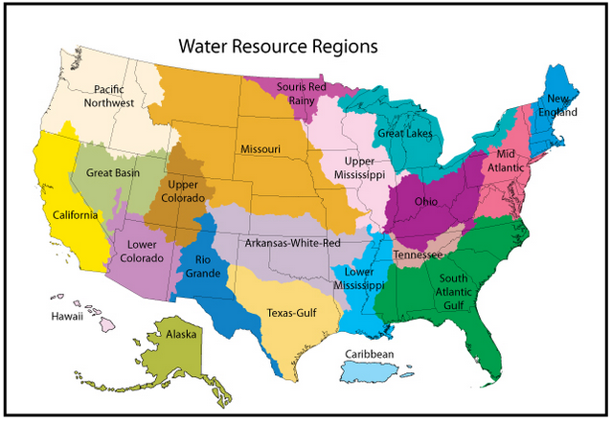
Watershed
Click on the following link to Locate Your Watershed in the U.S.

Slide 44
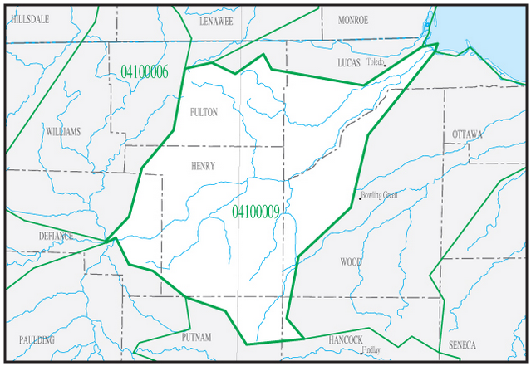
Lower Maumee Watershed

Slide 45
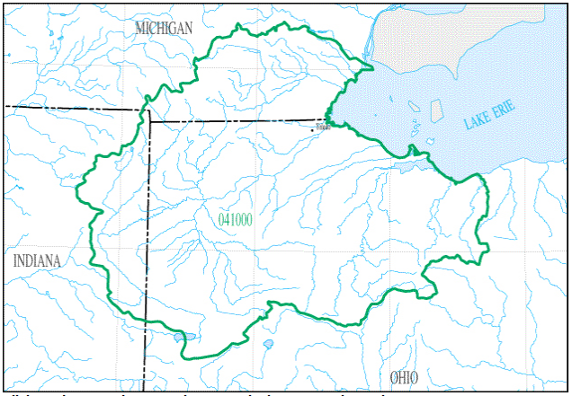
Western Lake Erie Watershed

Slide 46
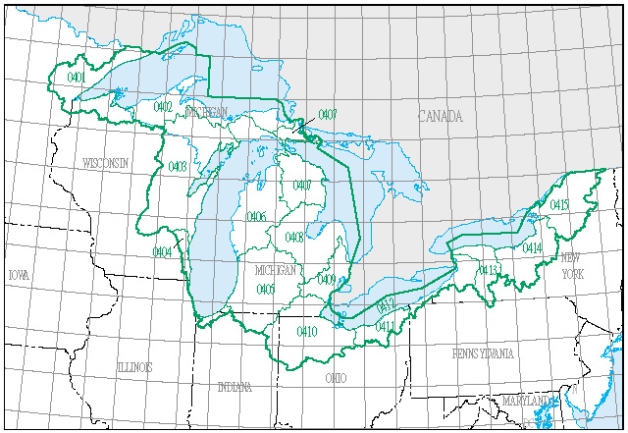
Great Lakes Watershed (U.S.)

Slide 47
Requirement 4
Do the following:
  Explain what a watershed is.
  Outline the smallest watershed that you can find on a contour map.
  Outline, as far as the map will allow, the next larger watershed which also has the smaller one in it.
  Explain what a river basin is. Tell why all people living in a river basin should be concerned about land and water use in the basin.
  Explain what an aquifer is and why it can be important to communities.

Slide 48
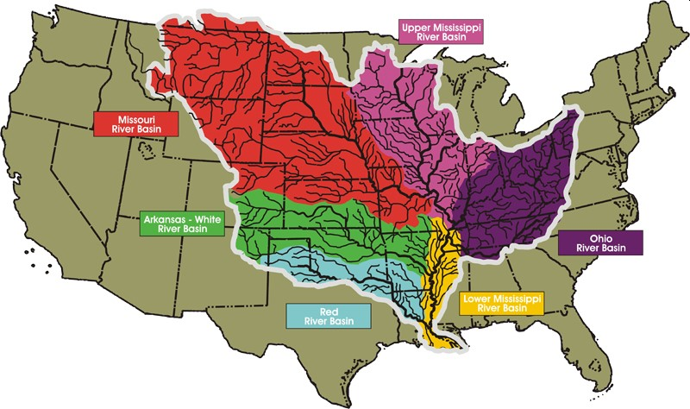
River Basin
A River Basin is the portion of land drained by a river and its tributaries.
It encompasses all of the land surface dissected and drained by many streams and creeks that flow downhill into one another, and eventually into a major river.

Slide 49
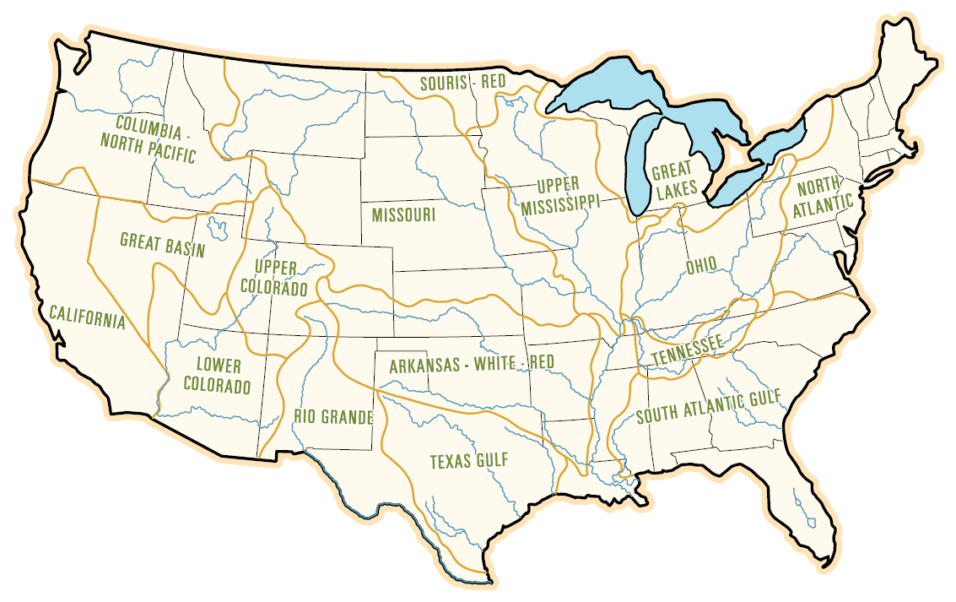
Water Use in a River Basin
The continental United States has 18 major river basins; in each basin are combinations of rural areas, industrial sites, and cities, and all depend on the water in that basin because very little water moves between river basins.
The way that land and water are used and managed affects the quality and quantity of water that people downstream will have.

Slide 50
Requirement 4
Do the following:
  Explain what a watershed is.
  Outline the smallest watershed that you can find on a contour map.
  Outline, as far as the map will allow, the next larger watershed which also has the smaller one in it.
  Explain what a river basin is. Tell why all people living in a river basin should be concerned about land and water use in the basin.
  Explain what an aquifer is and why it can be important to communities.

Slide 51
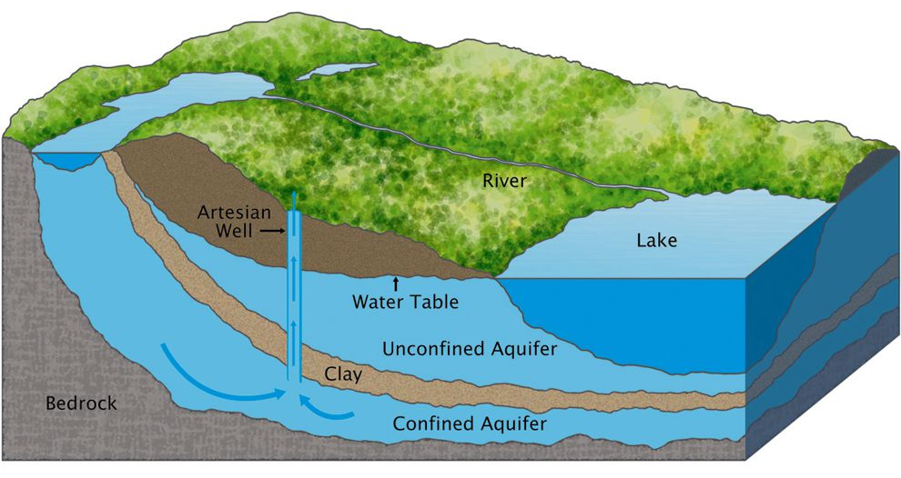
Aquifer
An Aquifer is a body of porous rock or sediment saturated with groundwater.
Groundwater enters an aquifer as precipitation seeps through the soil.
Water moves through the aquifer and resurfaces through springs and wells.

Slide 52
Requirement 5
Do the following:
  Make a drawing to show the hydrologic cycle.
  Demonstrate at least two of the following actions of water in relation to the soil: percolation, capillary action, precipitation, evaporation, transpiration.
  Explain how removal of vegetation will affect the way water runs off a watershed.
  Tell how uses of forest, range, and farmland affect usable water supply.
  Explain how industrial use affects water supply.

Slide 53
Hydrologic Cycle
The Hydrologic Cycle is the motion of the water from the ground to the atmosphere and back again.

Slide 54
Requirement 5
Do the following:
  Make a drawing to show the hydrologic cycle.
  Demonstrate at least two of the following actions of water in relation to the soil: percolation, capillary action, precipitation, evaporation, transpiration.
  Explain how removal of vegetation will affect the way water runs off a watershed.
  Tell how uses of forest, range, and farmland affect usable water supply.
  Explain how industrial use affects water supply.

Slide 55
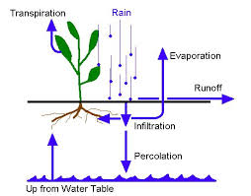
Percolation
Percolation refers to filtration of water through soil and permeable rocks.
After penetrating soil that is already wet, water may continue moving downward through the soil by percolation.
Percolation is the major means by which groundwater supplies are replenished.

Slide 56
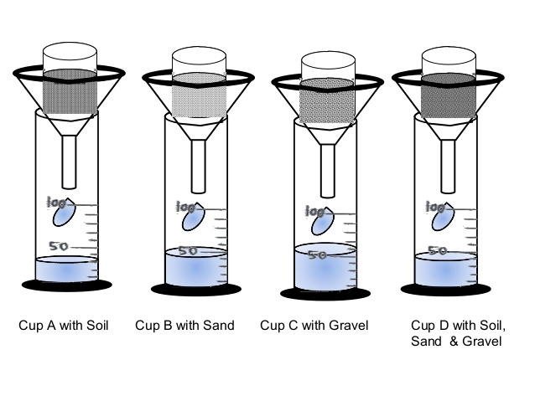
Demonstrating Percolation
Materials Required:
  4 Paper cups
  Sand
  Topsoil
  Gravel
  Filter paper
  Funnels
  100ml measuring cylinder or vessels of known volume
  Stopwatch or any watch
  Soil Sand Gravel
Directions:
Use a paperclip to poke several holes in the bottom of each paper cup. Each cup should have the same number of holes located at approximately in the same spots.
With the filter paper cover the bottom of each cup, place the cups on a funnel resting on the top of the measuring jar.
Label the cups A, B, C and D.
Fill half of Cup A with soil, fill half of Cup B with sand, fill half of Cup C with gravel, and fill half of Cup D with equal amounts of soil, sand & gravel.
Measure 100 ml of water and pour it into Cup A.
Record the time taken for 50 ml of water to drain into the measuring cylinder.
Repeat the procedure for cups B, C, and D.
Compare and discuss results.

Slide 57
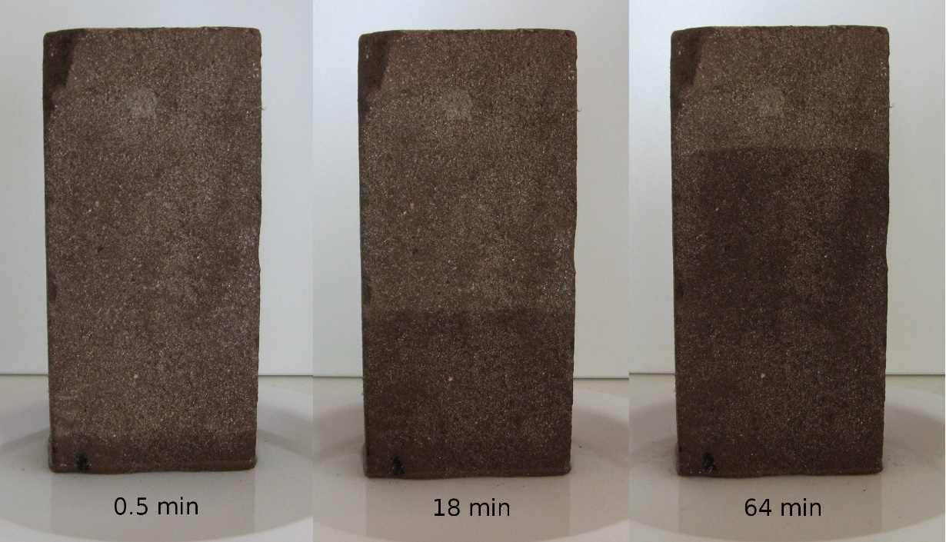
Capillary Action
Capillary Action is the movement of water within the spaces of a porous material due to the forces of adhesion, cohesion, and surface tension, the same effect that causes porous materials, such as sponges, to soak up liquids.
Capillary action helps bring water up into the roots and plants couldn't thrive without it.
Water, which contains dissolved nutrients, gets inside the roots and starts climbing up the plant tissue.

Slide 58
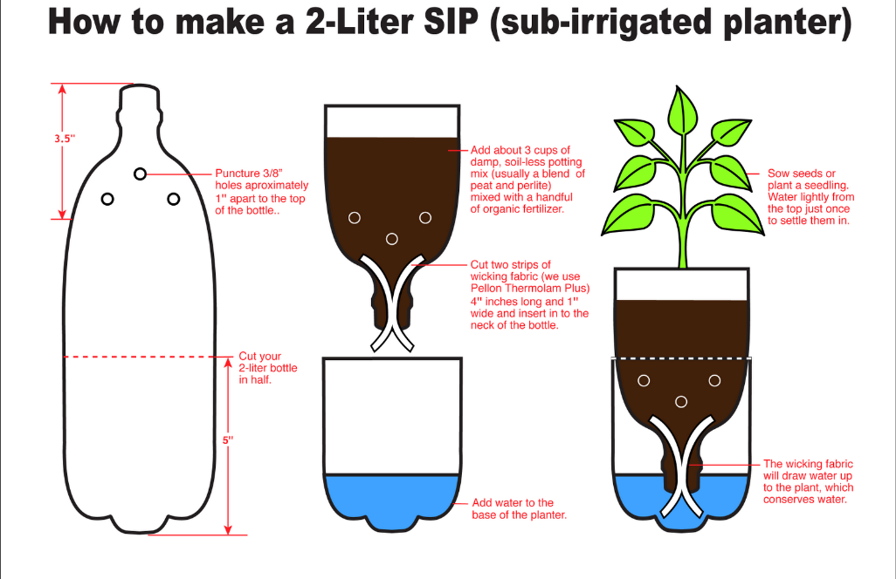
Demonstrating Capillary Action

Slide 59
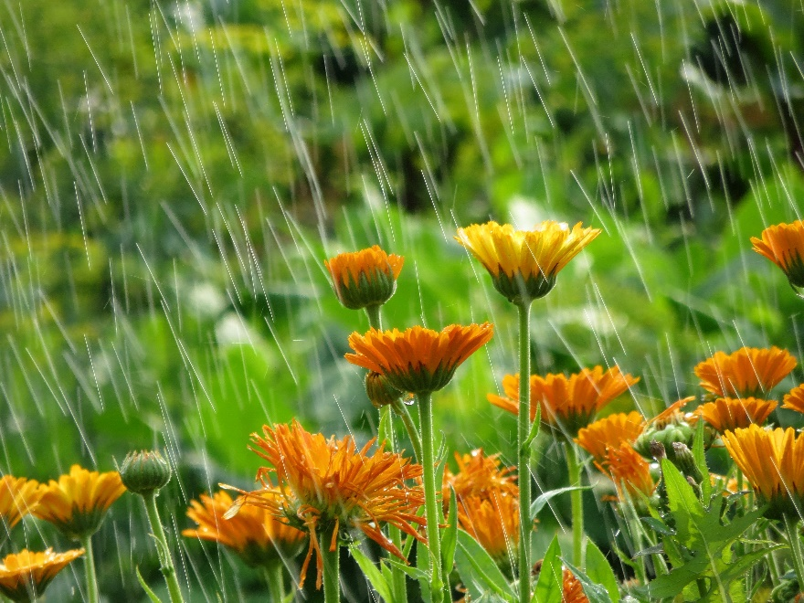
Precipitation
Precipitation is any product of the condensation of atmospheric water vapor that falls under gravity from clouds.
The main forms of precipitation include drizzle, rain, sleet, snow, ice pellets, and hail.

Slide 60
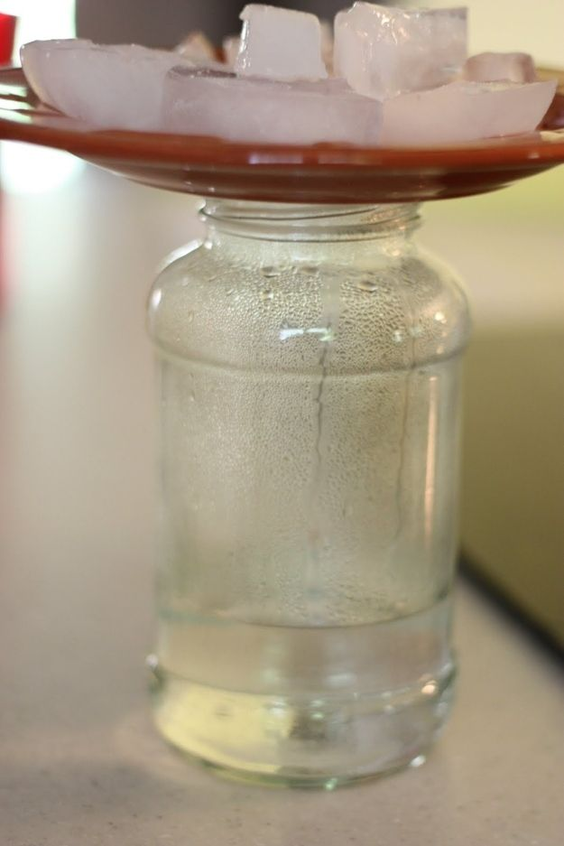
Demonstrating Precipitation
Materials:
Glass canning jar
Ceramic plate
Hot water
4 ice cubes
Instructions:
Pour two inches of the hot water into the canning jar.
Cover the jar with the ceramic plate face up.
Wait 3 minutes to continue to the next step.
Put ice cubes on the plate.
Observe your homemade water cycle.
How it Works:
What happens? The cold plate causes the moisture in the warm air, which is inside the jar to condense and form water droplets. This is the same thing that happens in the atmosphere. Warm, moist air rises and meets colder air high in the atmosphere. The water vapor condenses and forms precipitation that falls to the ground.

Slide 61
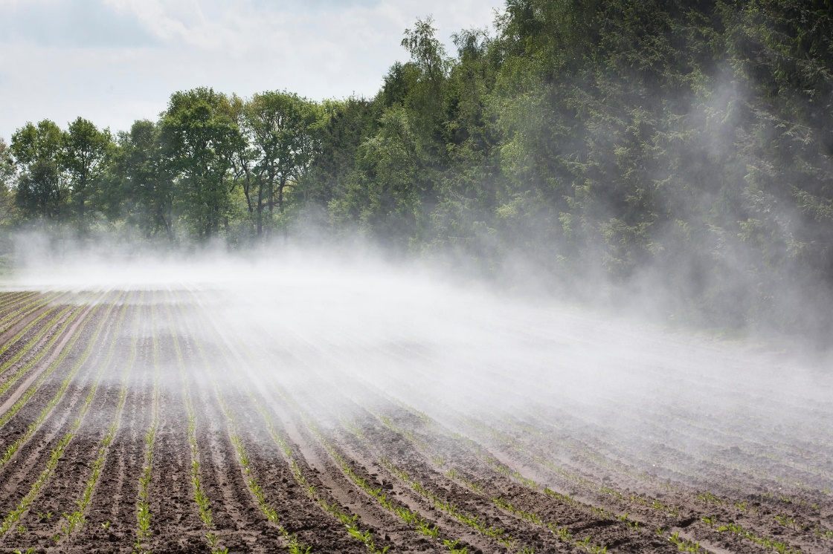
Evaporation
Evaporation is the process by which water changes from a liquid to a gas or vapor.
Evaporation is the primary pathway that water moves from the liquid state back into the water cycle as atmospheric water vapor.

Slide 62
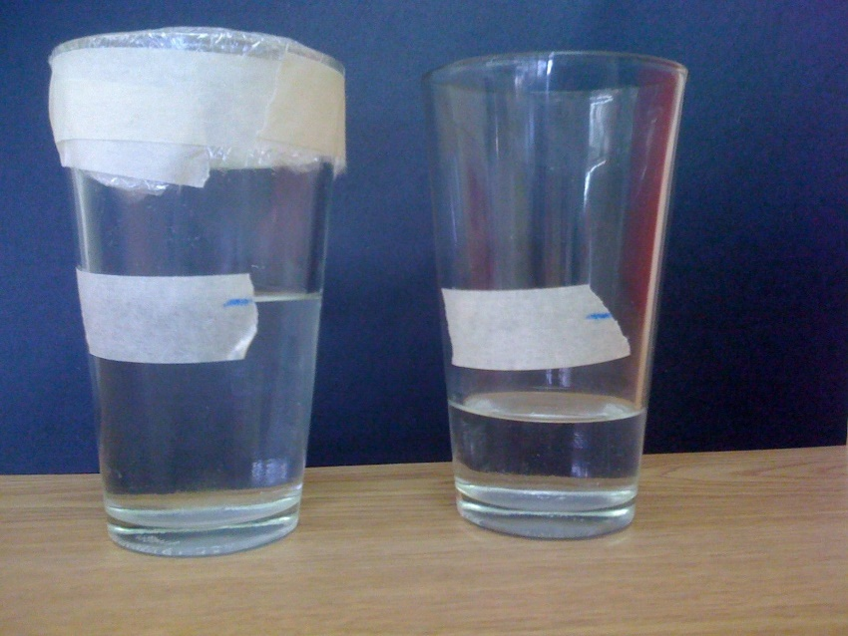
Demonstrating Evaporation
Fill two identical plastic cups with the same amount of water.
Mark the levels with a marker.
Place plastic wrap over one of the cups.
Put the cups near a window and leave them for a day.
Observe and mark the levels.
Do this for several days. Students will note that the water level is going down in the uncovered cup. Explain how evaporation works and where the water has gone.

Slide 63
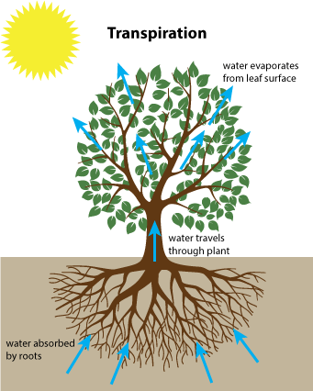
Transpiration
Transpiration is the evaporation of water from plants.
Most of the water absorbed by the roots of a plant—as much as 99.5 percent—is not used for growth or metabolism; it is excess water, and it leaves the plant through transpiration.
Transpiration is very important for maintaining moisture conditions in the environment.
As much as 10 percent of the moisture in the Earth’s atmosphere is from transpiration of water by plants.

Slide 64
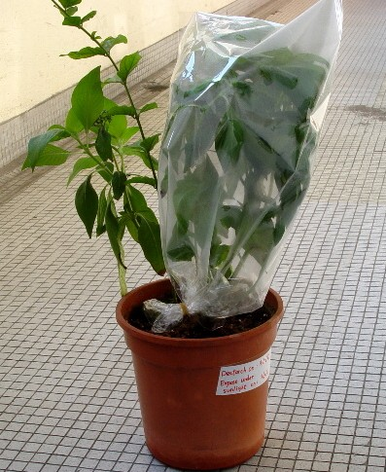
Demonstrating Transpiration
To see transpiration happening for yourself, try this experiment.
Place an airtight, transparent plastic bag over a common potted houseplant and tie it fairly tightly around the plant stem near the surface of the soil.
Then set the plant in the sunlight.
Soon you will see drops of water collecting on the inside of the plastic bag.

Slide 65
Requirement 5
Do the following:
  Make a drawing to show the hydrologic cycle.
  Demonstrate at least two of the following actions of water in relation to the soil: percolation, capillary action, precipitation, evaporation, transpiration.
  Explain how removal of vegetation will affect the way water runs off a watershed.
  Tell how uses of forest, range, and farmland affect usable water supply.
  Explain how industrial use affects water supply.

Slide 66
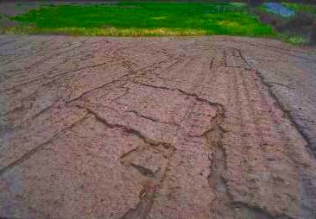
Vegetation Loss
Plants slow down water as it flows over the land and this allows much of the rain to soak into the ground.
Plant roots hold the soil in position and prevent it from being blown or washed away.
Plants break the impact of a raindrop before it hits the soil, reducing the soil's ability to erode.
Without plant cover, erosion can occur and sweep the land into rivers.

Slide 67
Requirement 5
Do the following:
  Make a drawing to show the hydrologic cycle.
  Demonstrate at least two of the following actions of water in relation to the soil: percolation, capillary action, precipitation, evaporation, transpiration.
  Explain how removal of vegetation will affect the way water runs off a watershed.
  Tell how uses of forest, range, and farmland affect usable water supply.
  Explain how industrial use affects water supply.

Slide 68
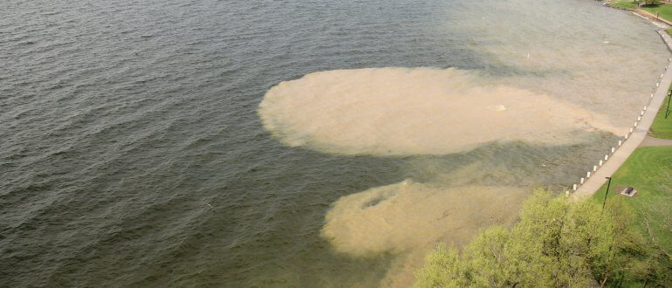
Erosion and Water Supply
When we use, remove, or change the kind of plants on the land, we usually change the quantity and quality of runoff.
  Loss of forest and vegetative cover can increase runoff which can accelerate soil erosion and increase the sediment load and turbidity of water sources, thus decreasing the water quality.
  Nutrients and pesticides may also wash into the streams decreasing water quality.
  Poor grazing management can result in contamination of surface and subsurface waters through bacterial contamination, nutrient over-enrichment, and soil erosion from pastures.

Slide 69
Requirement 5
Do the following:
  Make a drawing to show the hydrologic cycle.
  Demonstrate at least two of the following actions of water in relation to the soil: percolation, capillary action, precipitation, evaporation, transpiration.
  Explain how removal of vegetation will affect the way water runs off a watershed.
  Tell how uses of forest, range, and farmland affect usable water supply.
  Explain how industrial use affects water supply.

Slide 70
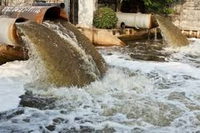
Industrial Use and Water Supply
Whether it's the food we eat or the products we consume, water is required for nearly every step of production across a multitude of different industries.
As many industrial facilities use freshwater to carry away waste from the plant and into rivers, lakes and oceans, there is a responsibility to ensure pollutants are removed and minimized before water pollution gets into the rivers and also the ground which leads to our well water.

Slide 71
Requirement 6
Do the following:
  Tell what is meant by "water pollution".
  Describe common sources of water pollution and explain the effects of each.
  Tell what is meant by "primary water treatment," "secondary waste treatment," and "biochemical oxygen demand."
  Make a drawing showing the principles of complete waste treatment.

Slide 72
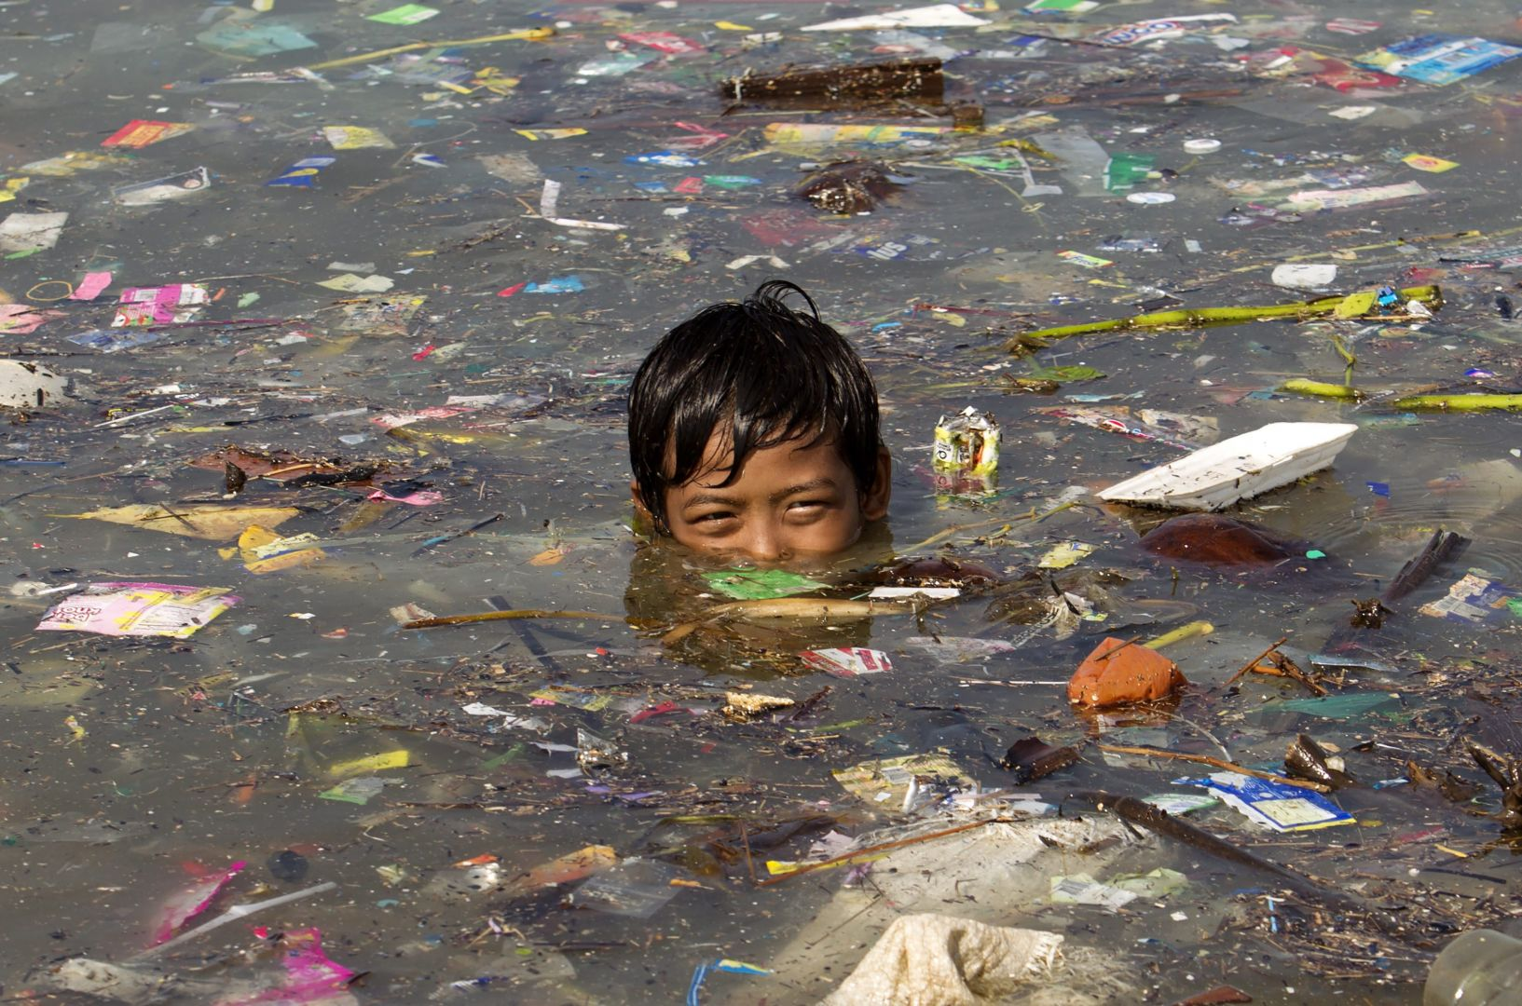
Water Pollution
Water Pollution occurs when harmful substances—often chemicals or microorganisms—contaminate a stream, river, lake, ocean, aquifer, or other body of water, degrading water quality and rendering it toxic to humans or the environment.

Slide 73
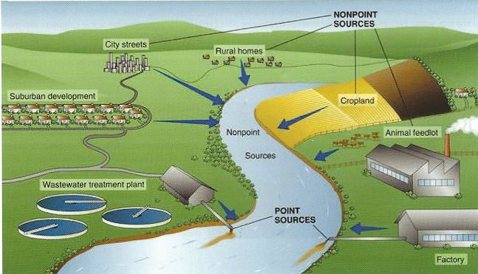
Water Pollution
Point Source Pollution has an identifiable location from which the pollutants are coming, such as an industrial or sewage-treatment plant.
Nonpoint Source Pollution has no single identifiable source and is caused by runoff moving over, through, and into the ground, picking up pollutants on the way. It usually is associated with changes in land use, or land used beyond its capabilities.

Slide 74
Requirement 6
Do the following:
  Tell what is meant by "water pollution".
  Describe common sources of water pollution and explain the effects of each.
  Tell what is meant by "primary water treatment," "secondary waste treatment," and "biochemical oxygen demand."
  Make a drawing showing the principles of complete waste treatment.

Slide 75

Common Sources of Water Pollution

Slide 76

Sewage and Wastewater
Used water is wastewater that comes from our sinks, showers, and toilets and from commercial, industrial, and agricultural activities.
The term also includes stormwater runoff, which occurs when rainfall carries road salts, oil, grease, chemicals, and debris from impermeable surfaces into our waterways
More than 80 percent of the world’s wastewater flows back into the environment without being treated or reused.

Slide 77

Sediment
Soil washed from its source and deposited where it is not wanted is called sediment.
It is estimated that about half of the soil that erodes each year in the United States reaches our rivers, streams, and lakes.
Much of the sediment in surface waters comes from erosion on poorly managed rural lands, but a good deal comes from unprotected areas in or near cities, such as urban construction sites.

Slide 78

Organic Chemicals
Many materials that pollute water are organic chemicals, such as pesticides and herbicides, insecticides, fungicides, and petroleum derivatives.
These and other chemicals enter the water by being washed off the land.
They usually move with soil particles carried by runoff—another important reason for controlling erosion and runoff.

Slide 79


Salts and Mineral Substances
Salt levels are rising in freshwater lakes and streams from road salting and oil and gas wastewater.
Salt is a major irrigation problem in the Southwest and improved management of water used for irrigation can help ease this problem.

Slide 80

Acid Mine Wastes
Acid-mine waste has severely damaged some streams and rivers.
Coal and other minerals are frequently mined by using huge machines to strip away layers of soil and rock so that the minerals can be scooped up and hauled away by a process called strip mining.
The waste materials from this type of mining contain chemicals such as sulfur, which, when combined with water from rain or snow, form strong acids.
If enough of this acid water gets into a creek or river, no aquatic plants or animals can survive.
A stream receiving acid drainage from surface coal mining.

Slide 81

Oil Pollution
Big spills may dominate headlines, but consumers account for the vast majority of oil pollution in our seas, including oil and gasoline that drips from millions of cars and trucks every day.
Moreover, nearly half of the estimated 1 million tons of oil that makes its way into marine environments each year comes not from tanker spills but from land-based sources such as factories, farms, and cities.

Slide 82




Radioactive Substances
Radioactive Waste is any pollution that emits radiation beyond what is naturally released by the environment.
It’s generated by uranium mining, nuclear power plants, and the production and testing of military weapons, as well as by universities and hospitals that use radioactive materials for research and medicine.
Radioactive waste can persist in the environment for thousands of years, making disposal a major challenge.
Accidentally released or improperly disposed of contaminants threaten groundwater, surface water, and marine resources.

Slide 83


Thermal Pollution
Thermal Pollution comes from hot water being dumped into a body of water changing its temperature so that it is less useful.
When large amounts of water are used for cooling purposes in industrial processes, air conditioning, electric power production, and other ways, the stream’s temperature can be raised.
It is a growing problem and many aquatic plants and animals cannot survive for long in lakes and streams where the water temperature is much warmer than normal.

Slide 84

Effects of Water Pollution on Human Health
Water pollution kills.
  It caused 1.8 million deaths in 2015.
Contaminated water can also make you ill.
  Every year, unsafe water sickens about 1 billion people and low-income communities are disproportionately at risk because their homes are often closest to the most polluting industries.
  Waterborne pathogens, in the form of disease-causing bacteria and viruses from human and animal waste, are a major cause of illness from contaminated drinking water.
  Diseases spread by unsafe water include cholera, giardia, and typhoid.
Even in wealthy nations, accidental or illegal releases from sewage treatment facilities, as well as runoff from farms and urban areas, contribute harmful pathogens and chemicals to waterways.

Slide 85


Effects of Water Pollution on the Environment
When water pollution causes an algal bloom in a lake or marine environment, the proliferation of newly introduced nutrients stimulates plant and algae growth, which in turn reduces oxygen levels in the water.
  This dearth of oxygen, known as eutrophication, suffocates plants and animals and can create “dead zones,” where waters are essentially devoid of life.
  In certain cases, these harmful algal blooms can also produce neurotoxins that affect wildlife, from whales to sea turtles.

Slide 86

Effects of Water Pollution on the Environment
Chemicals and heavy metals from industrial and municipal sources contaminate waterways as well.
These contaminants are toxic to aquatic life—most often reducing an organism’s life span and ability to reproduce—and make their way up the food chain as predator eats prey.
That’s how tuna and other big fish accumulate high quantities of toxins, such as mercury.

Slide 87

Effects of Water Pollution on the Environment
Marine ecosystems are also threatened by marine debris, which can strangle, suffocate, and starve animals.
Much of this solid debris, such as plastic bags and soda cans, gets swept into sewers and storm drains and eventually out to sea, turning our oceans into trash soup and sometimes consolidating to form floating garbage patches.
Discarded fishing gear and other types of debris are responsible for harming more than 200 different species of marine life.

Slide 88

Effects of Water Pollution on the Environment
Ocean acidification is making it tougher for shellfish and coral to survive.
By absorbing about a quarter of the carbon pollution created each year from burning fossil fuels, oceans are becoming more acidic.
This process makes it harder for shellfish and other species to build shells and may impact the nervous systems of sharks, clownfish, and other marine life.

Slide 89
Requirement 6
Do the following:
  Tell what is meant by "water pollution".
  Describe common sources of water pollution and explain the effects of each.
  Tell what is meant by "primary water treatment," "secondary waste treatment," and "biochemical oxygen demand."
  Make a drawing showing the principles of complete waste treatment.

Slide 90

Primary Wastewater Treatment
Primary Treatment of Wastewater involves sedimentation of solid waste within the water.
This is done after filtering out larger contaminants within the water.
Wastewater is passed through several tanks and filters that separate water from contaminants.
The resulting “sludge” is then fed into a digester, in which further processing takes place.
This primary batch of sludge contains nearly 50% of suspended solids within wastewater.

Slide 91
Secondary Wastewater Treatment
Secondary Treatment of Wastewater makes use of oxidation to further purify wastewater. This can be done in one of three ways:
Biofiltration
  This method of secondary treatment of wastewater employs sand filters, contact filters, or trickling filters to ensure that additional sediment is removed from wastewater. Of the three filters, trickling filters are typically the most effective for small-batch wastewater treatment.
Aeration
  Aeration is a long, but effective process that entails mixing wastewater with a solution of microorganisms. The resulting mixture is then aerated for up to 30 hours at a time to ensure results.
Oxidation Ponds
  Oxidation ponds are typically used in warmer places. In addition, this method utilizes natural bodies of water like lagoons. Wastewater is allowed to pass through this body for a period of time and is then retained for two to three weeks.

Slide 92
Tertiary Waste Treatment
Tertiary Wastewater Treatment is the third and last step in the basic wastewater management system.
It is mostly comprised of removing phosphates and nitrates from the water supply.
Substances like activated carbon and sand are among the most commonly used materials that assist in this process.

Slide 93

Biochemical Oxygen Demand
Biochemical Oxygen Demand (BOD) is the amount of dissolved oxygen needed by aerobic biological organisms to break down organic material present in a given water sample at certain temperature over a specific time period.
Higher BOD levels usually indicate a higher level of organic pollution from sewage or manure.

Slide 94
Requirement 6
Do the following:
  Tell what is meant by "water pollution".
  Describe common sources of water pollution and explain the effects of each.
  Tell what is meant by "primary water treatment," "secondary waste treatment," and "biochemical oxygen demand."
  Make a drawing showing the principles of complete waste treatment.

Slide 95

Principles of Complete Waste Treatment

Slide 96
Requirement 7
Do TWO of the following:
  Make a trip to two of the following places. Write a report of more than 500 words about the soil and water and energy conservation practices you saw.
    An agricultural experiment.
    A managed forest or a woodlot, range, or pasture.
    A wildlife refuge or a fish or game management area.
    A conservation-managed farm or ranch.
    A managed watershed.
    A waste-treatment plant.
    A public drinking water treatment plant.
    An industry water-use installation.
    A desalinization plant.
  Plant 100 trees, bushes and/or vines for a good purpose.
  Seed an area of at least one-fifth acre for some worthwhile conservation purposes, using suitable grasses or legumes alone or in a mixture.
  Study a soil survey report. Describe the things in it. Using tracing paper and pen, trace over any of the soil maps, and outline an area with three or more different kinds of soil. List each kind of soil by full name and map symbol.
  Make a list of places in your neighborhood, camps, school ground, or park having erosion, sedimentation, or pollution problems. Describe how these could be corrected through individual or group action.
  Carry out any other soil and water conservation project approved by your merit badge counselor.

